Slide 1
MICRO-PROCESSORS
Guided By: Mr. Mohammed Ali

Slide 2
PARTICIPANTS
210444 Mohinuddin Merchant
210451 Abdurrahman Qureshi
210454 Azlan Shaikh
210455 Qazi Mohammed Oaish
210459 Owais Khan Niyaz Ahmad Khan

Slide 3
WHAT IS A MICRO-PROCESSOR?
Computer's Central Processing Unit (CPU) built on a single Integrated Circuit (IC) is called a microprocessor.
A digital computer with one microprocessor which acts as a CPU is called microcomputer.

Slide 4
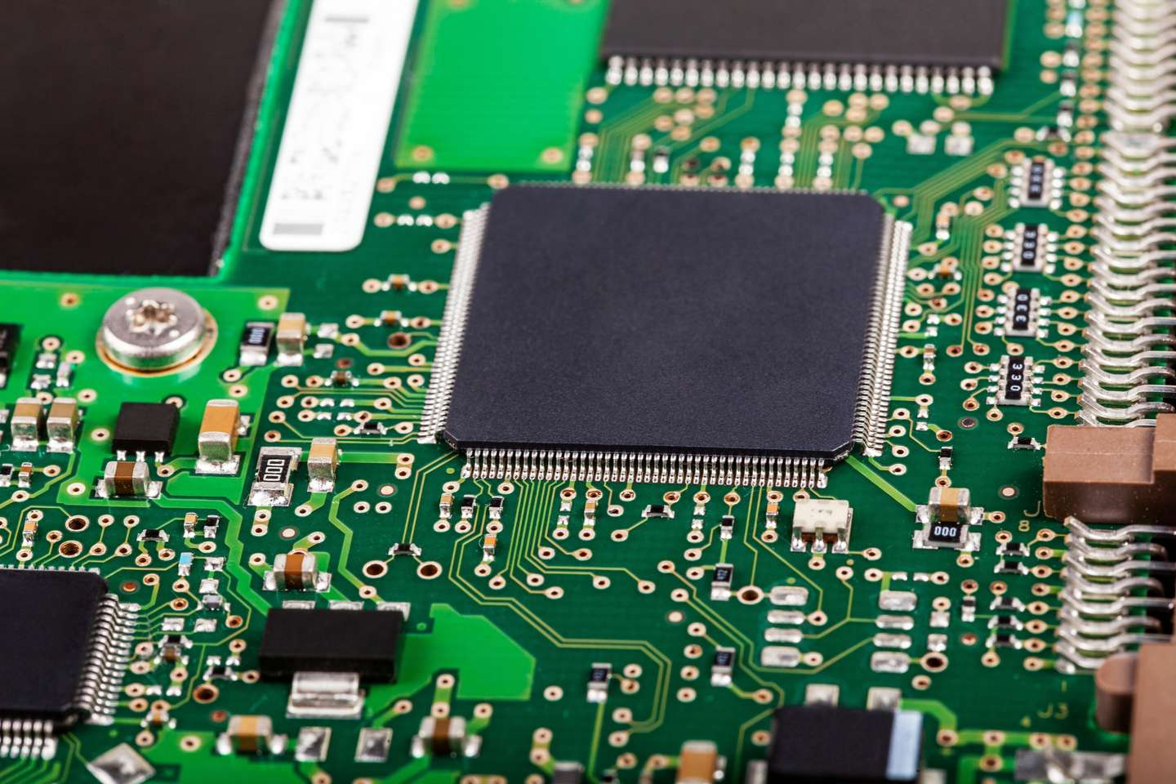
STRUCTURE OF A MICROPROCESSOR
The microprocessor contains millions of tiny components like transistors, registers, and diodes that work together.

Slide 5
EVOLUTION OF MICRO-PROCESSORS

Slide 6
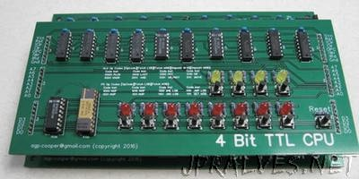
First Generation (4 - bit Microprocessors)
The first generation microprocessors were introduced in the year 1971-1972 by Intel Corporation. It was named Intel 4004 since it was a 4-bit processor.
It was a processor on a single chip. It could perform simple arithmetic and logical operations such as addition, subtraction, Boolean OR and Boolean AND.

Slide 7
SECOND AND THIRD GENERATIONS (8 BIT AND 16 BIT)
Second Generation (8 - bit Microprocessor)
Third Generation (16 - bit Microprocessor)
The second generation microprocessors were introduced in 1973 again by Intel. It was a first 8 - bit microprocessor which could perform arithmetic and logic operations on 8-bit words. It was Intel 8008, and another improved version was Intel 8088.
The third generation microprocessors, introduced in 1978 were represented by Intel's 8086, Zilog Z800 and 80286, which were 16 - bit processors with a performance like minicomputers.

Slide 8
FOURTH AND FIFTH GENERATIONS (32 BIT AND 64 BIT)
Fourth Generation (32 - bit Microprocessors)
Fifth Generation (64 - bit Microprocessors)
Several different companies introduced the 32-bit microprocessors, but the most popular one is the Intel 80386.
From 1995 to now we are in the fifth generation. After 80856, Intel came out with a new processor namely Pentium processor followed by Pentium Pro CPU, which allows multiple CPUs in a single system to achieve multiprocessing.
Other improved 64-bit processors are Celeron, Dual, Quad, Octa Core processors.

